Slide 1
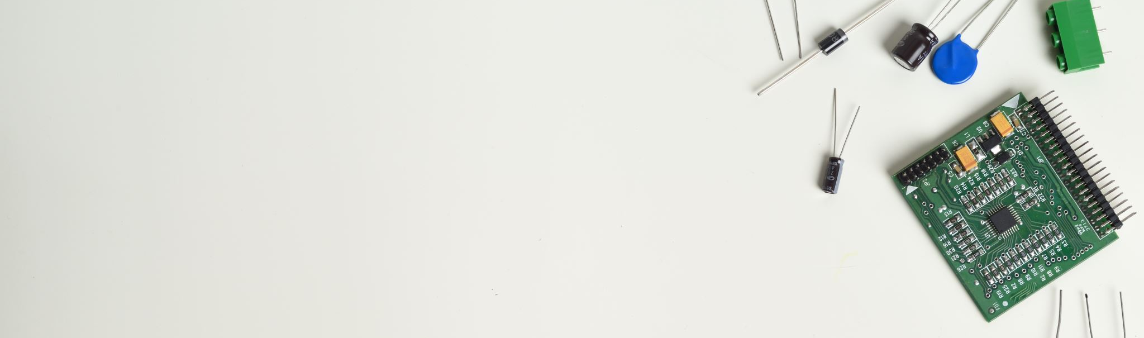
Home Automation Using Android and IR
Using Bluetooth and Arduino Module By:
SURYAVEER
suryaveeryadav2002@gmail.com

Slide 2
Problem Statement
Connecting home appliances to network makes life of human far more easier.
Old age person or those with disabilities has always faced problem with switch on and off home appliances.

Slide 3
Our Project
We have created a application which helps to connect these devices easily and provides voice control features as well as having GUI based buttons using mobile phone.
We also have created another circuit in which we can control our home appliances by using IR remote.

Slide 4
Software Used
Arduino Compiler
Proteus 8 Professional (virtual hardware simulator)
MIT App Inventor (for creating android app)
TinKercad

Slide 5
Hardware Used
Bluetooth based home Automation
Arduino UNO R3
Bluetooth HC-05 Module
Relay Modules
Resistors
Alternator
5v Battery
Led Light
Dc Motor
IR based home Automation
Arduino UNO R3
Relay Modules
Resistors
Power Supply
IR Sensor
IR Remote
Led Light
Dc Motor

Slide 6
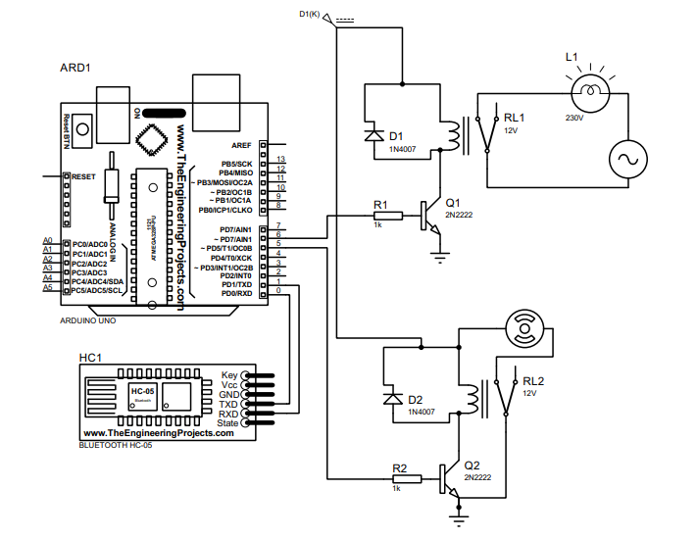
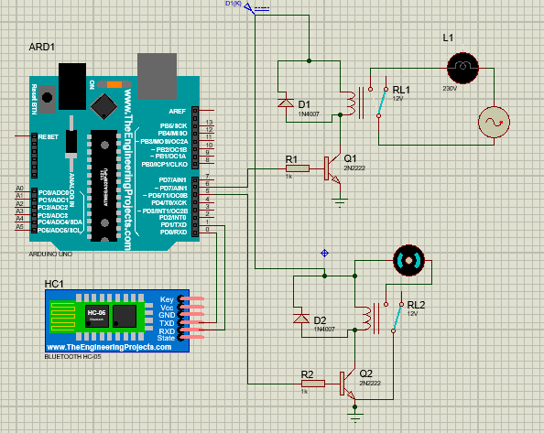
Circuit Diagram ( Bluetooth based)

Slide 7
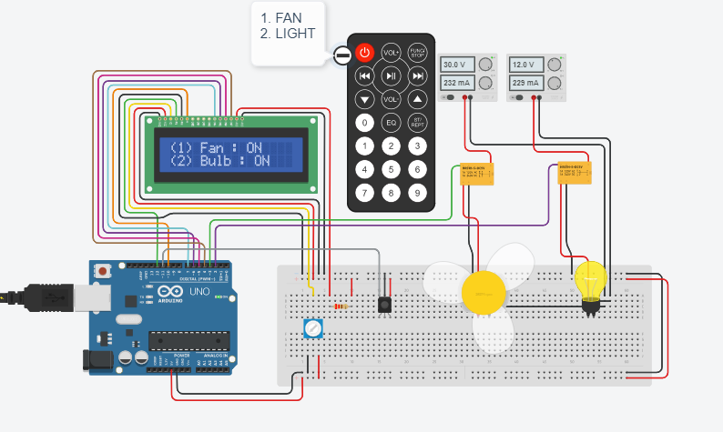
Circuit Diagram ( IR based)

Slide 8
Features
Used on android
Uses Bluetooth and arduino
Voice Control and GUI Control
Cost effective
Remote Control(IR)

Slide 9
Deliverables
Apk fie
Documentation
Video
Code
Simulation files

Slide 10

Thankyou

